Slide 1
Ovariohysterectomy
Assist. Rafid Majeed Naeem

Slide 2
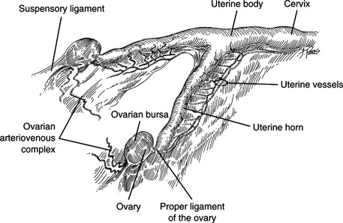
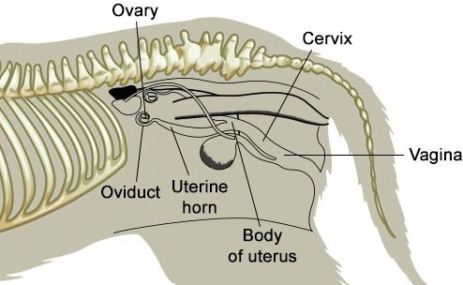
Ovary
شكل المبيض بيضوي , موقع المبيض في المجترات في مدخل الحوض أما في الكلاب و الأفراس والقطط فيكون تحت القطن مثبت داخل الجسم بواسطة اربطة :
.1 الرباط المساريقي المبيضي mesovarium الذي يصل المبيض بالرباط العريض
.2 الرباط المعلق المبيضي suspensory ligament
.3 الرباط الحقيقي proper ligament

Slide 3
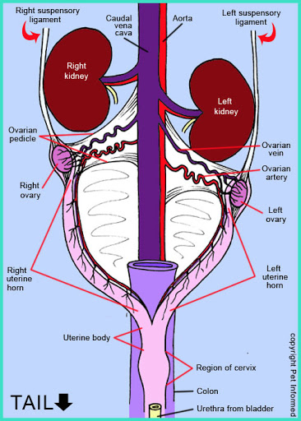
التجهيز الدموي blood supply
يكون عن طريق الشريان المبيضي ovarian artery الذي هو فرع من الشريان الابهرالبطني
الوريد المبيضي ovarian vein ويصب في الوريد الاجوف البطني

Slide 4
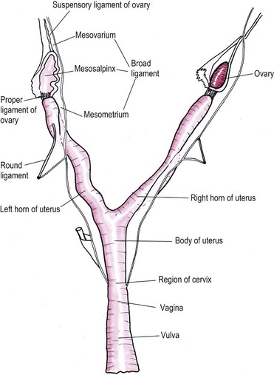
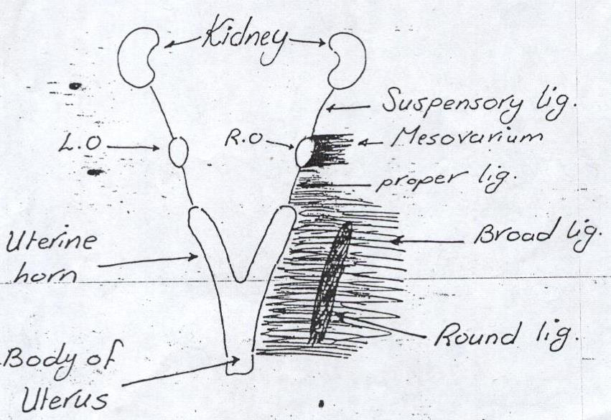
the uterus الرحم
the uterus consist of cervix, body and two horns the oviduct ( uterine tube ) connect between uterine horns and the ovaries. It lies in the caudal of abdomen between the descending colon and urinary bladder
يثبت الرحم بواسطة اربطة ligaments
.1 الرباط الرحمي العريض broad ligament
.2 الرباط المساريقي الرحمي mesometrium

Slide 5
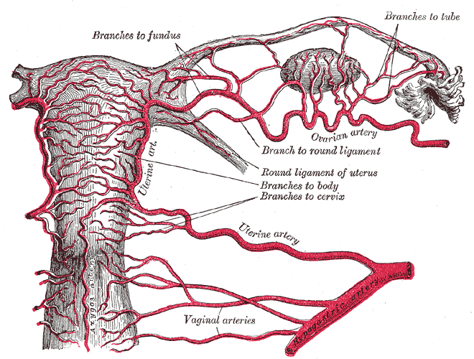
Blood supply
1. uterine branch of the internal iliac artery is the main artery to the uterus
2. the uterine branch of the urogenital artery supplies the caudal portion of the uterus, the cervix and part of vagina
3. the uterine branch of the ovarian artery supplies the cranial part of uterine horns

Slide 6
Ovariohysterectomy
1. to make the animal (bitch) socially acceptable
2. tumors and cysts of ovary and uterus
3. endometritis, metritis
4. some congenital condition
5. pseudo pregnancy (pseudocysis)
6. neglected dystocia
7. pyometra
8. mammary gland tumors, specially those due to hormonal disturbance
9. recurrent vaginal prolapse

Slide 7
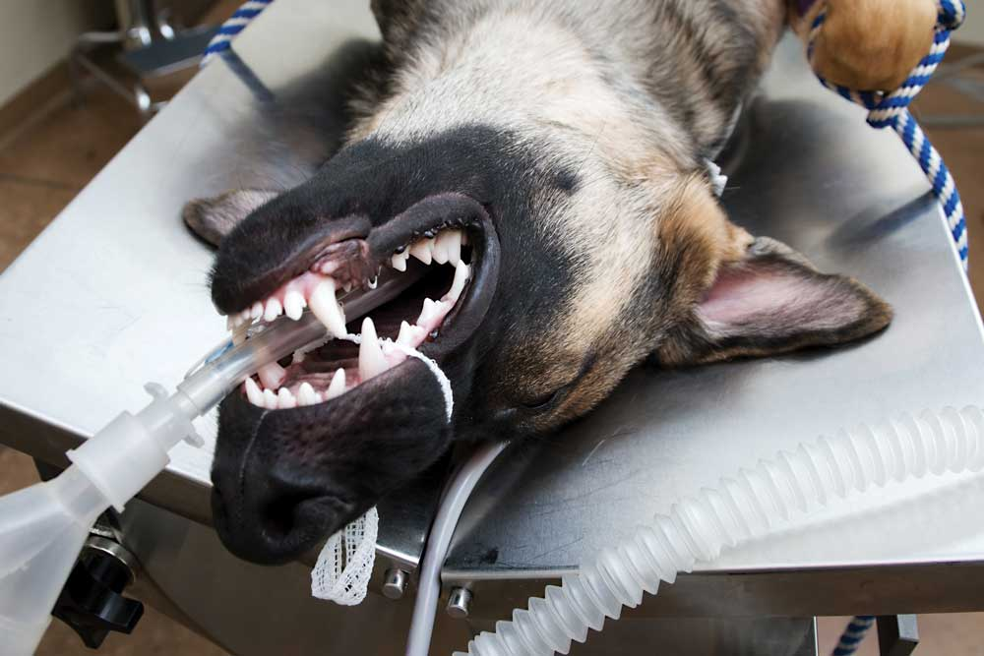
age of animal for Ovariohysterectomy
in bitches 6 months
in cat 9 months
Anesthesia
general anesthesia (inhalation or injection)

Slide 8
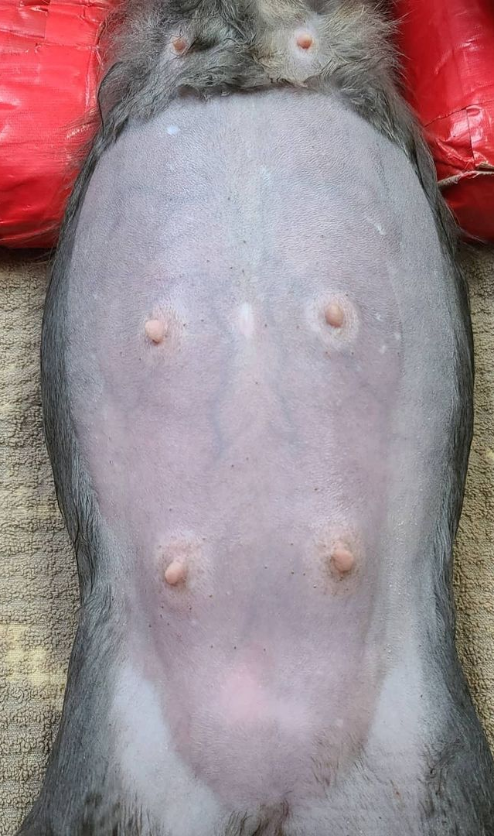
preparation for operation
in normal healthy animal, the animal with held for food before 24 hours and water 4 hours at day of operation
surgical preparation from xyphoid region to pubic region
animal is put in dorsal recumbence
animal in shock as a cases of pyometra, neglected dystocia, the animal should be treated first for 3-2 days prior to operation with systemic antibiotic penicillin +streptomycin + IV fluid therapy which should be given at time of operation and continuous post operatively for 3 days ,corticosteroids

Slide 9
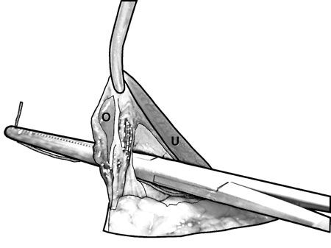
site of operation
midline (linea alba) Laprotomy
the incision is began slightly interior to umbilicus and down word for 7 cm or from the xyphoid cartilage to the pubic bone
first we search for uterine horn with a spying hook or index finger (displace the omentum and bowel cranially if necessary to find the uterus)
after identification of uterine horn we hold the proper ligament with Allis Forceps with hand we pulpate the suspensory ligament and break it by fingers when suspensory ligament is broken the ovary will come easily at the site of operation

Slide 10
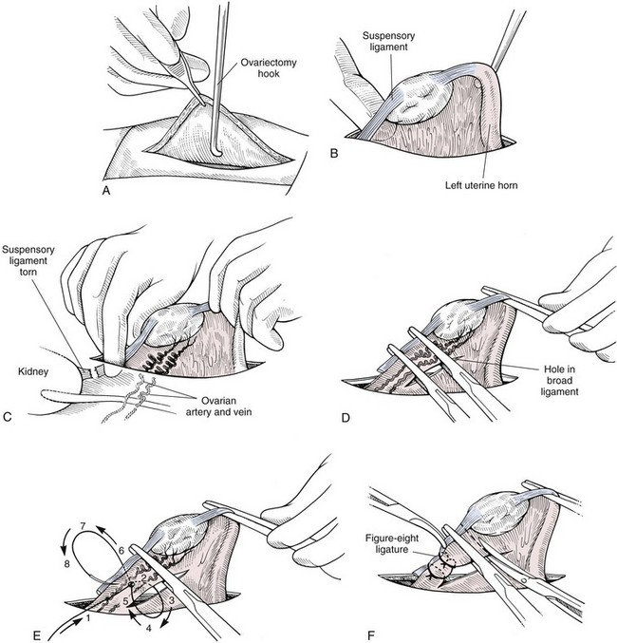

Slide 11
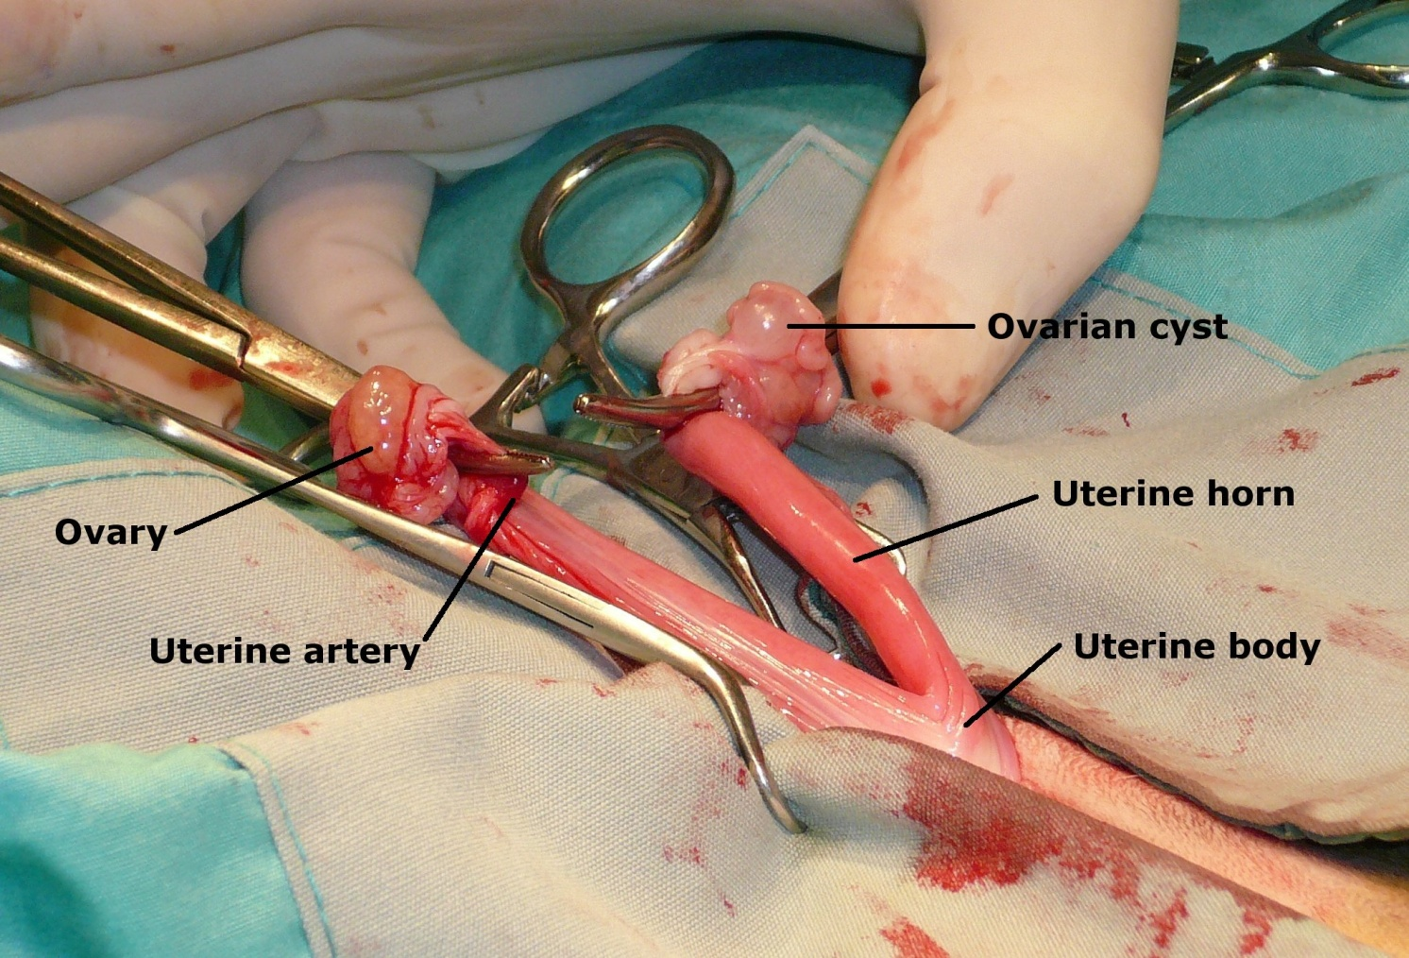
penetrate the masovarium then put 3 straight artery forceps (crush) the ovarian vessels, ligate the crushed vessels , cut between the other 2 forceps
the broad ligament is broken bluntly, left ovary and its attachment is separated from the body
the same technique is performed on the right ovary.
When both ovaries and uterine horns are separated

Slide 12
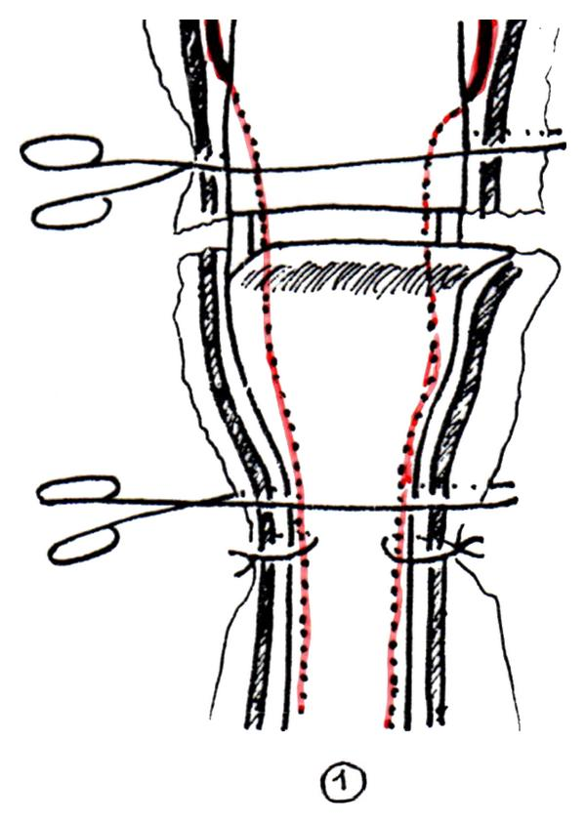
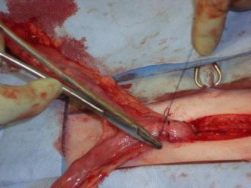
We search the body of the uterus. uterine vessels are double ligated and uterine body is double transfixing ligated
The cut between ligature and in case of pyometra or neglected dystocia, the cervix is also removed reaching the vagina
When the body of uterus is cut , put swap of tincture iodine then alcohol , then put parker ker suture (cushing suture) .

Slide 13
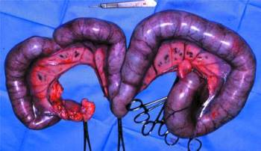
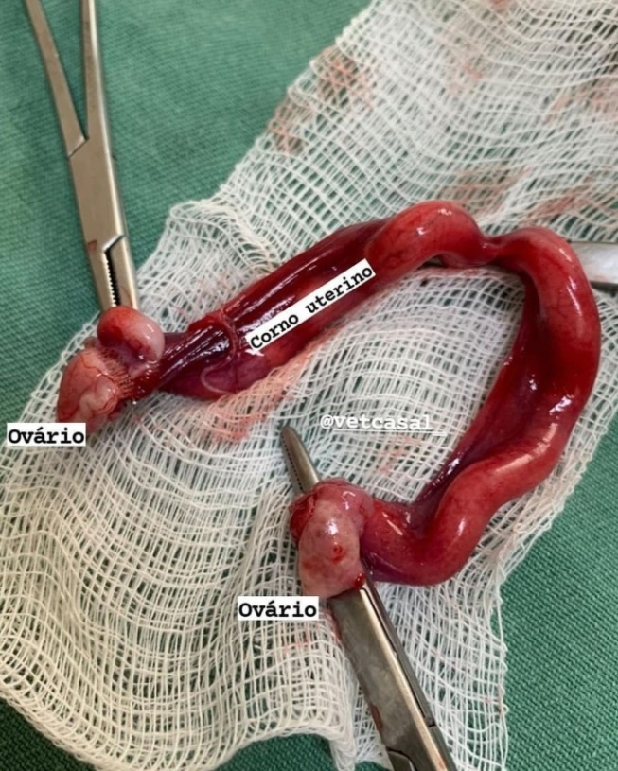
Then remove the ovaries and uterus
Local antibiotic (procaine penicillin) in the abdominal cavity and
close the abdominal wall with simple continuous suture for peritoneum and linea alba using chromic catgut and interrupted suture for skin using silk

Slide 14
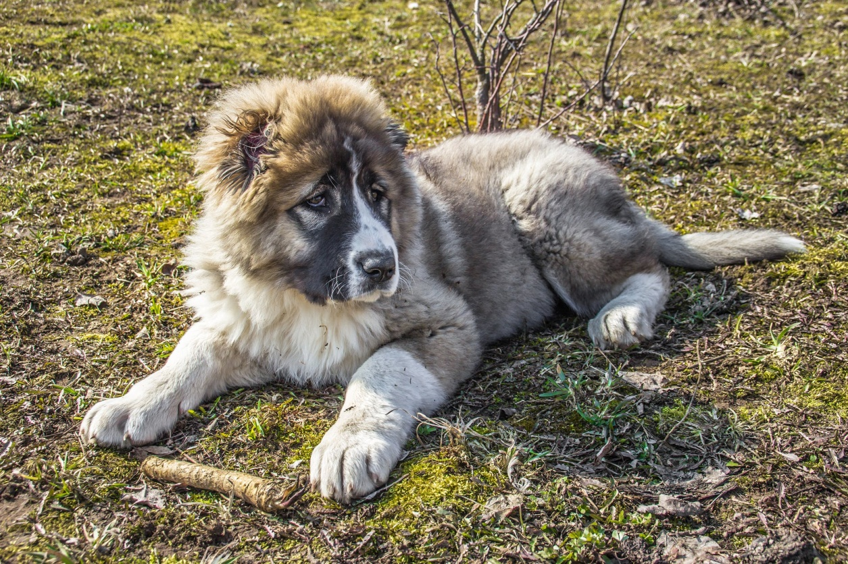
post operative care
systemic antibiotic for 3-4 days
remove the suture after 7-10 days
complications
1. bleeding
2. peritonitis
3. urine incontinence

